Slide 1
Charm® Mycotoxin Testing Solutions
Water Based Extractions and Methanol

Slide 2
Charm Company Overview

Slide 3
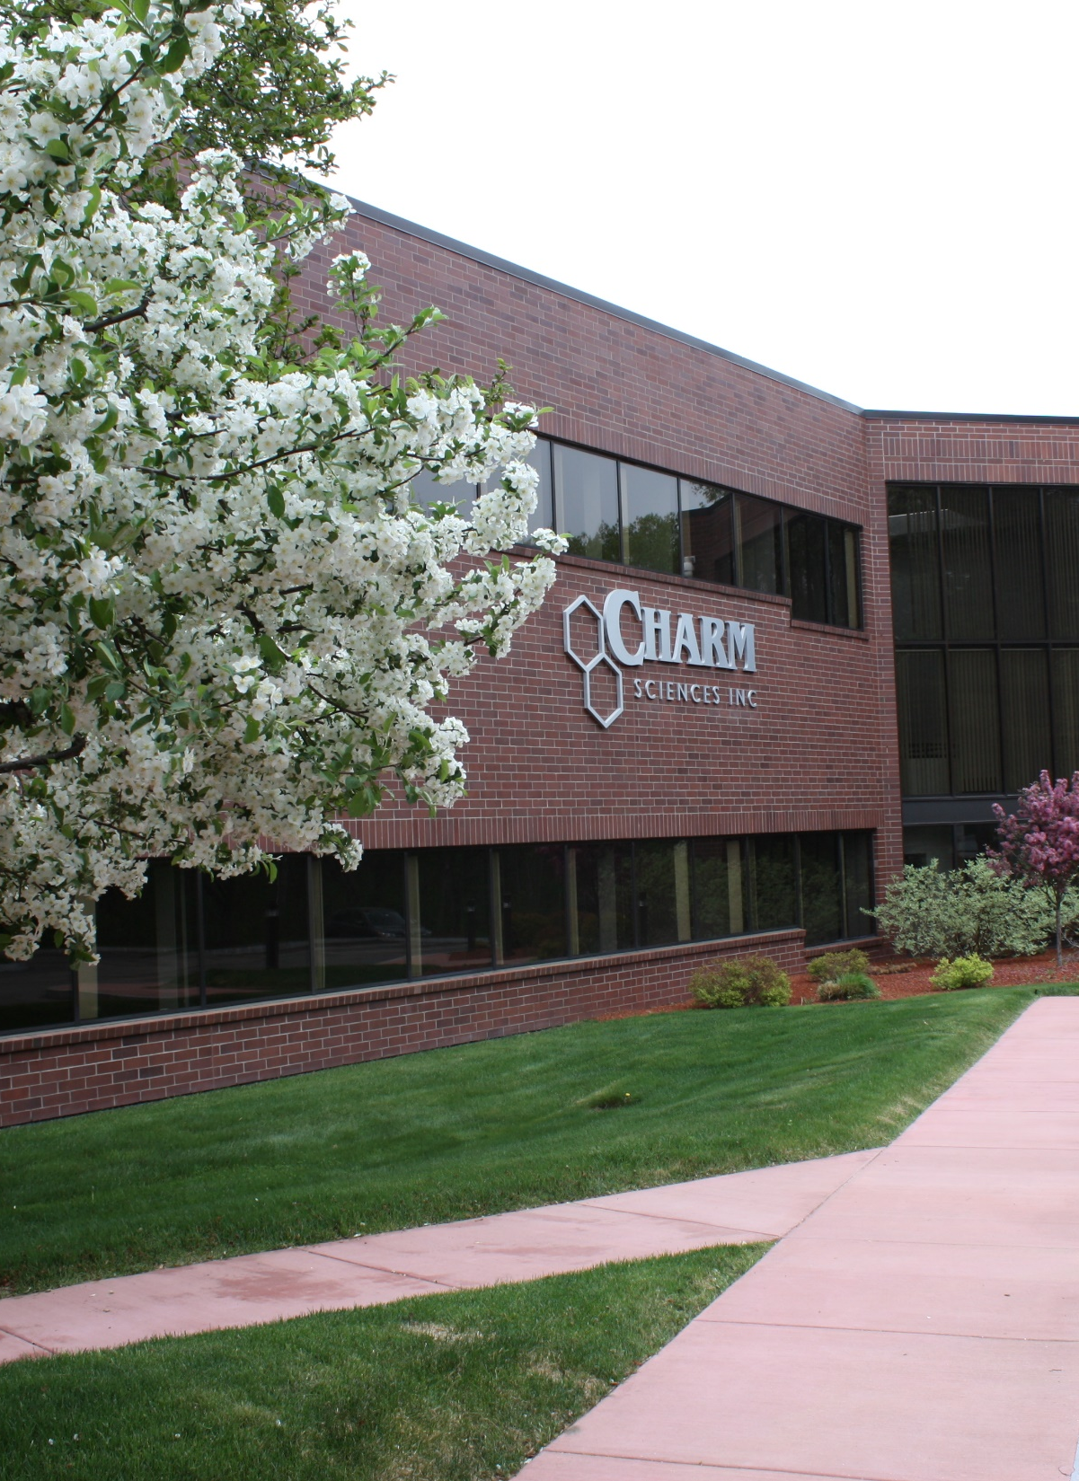


Charm Overview
Founded 1978 – development of first rapid antibiotic test for milk
3 manufacturing facilities in MA
Over 300 Employees
11 representatives located across US
3 Global Representatives
(Netherlands, Ghana and Thailand)

Slide 4
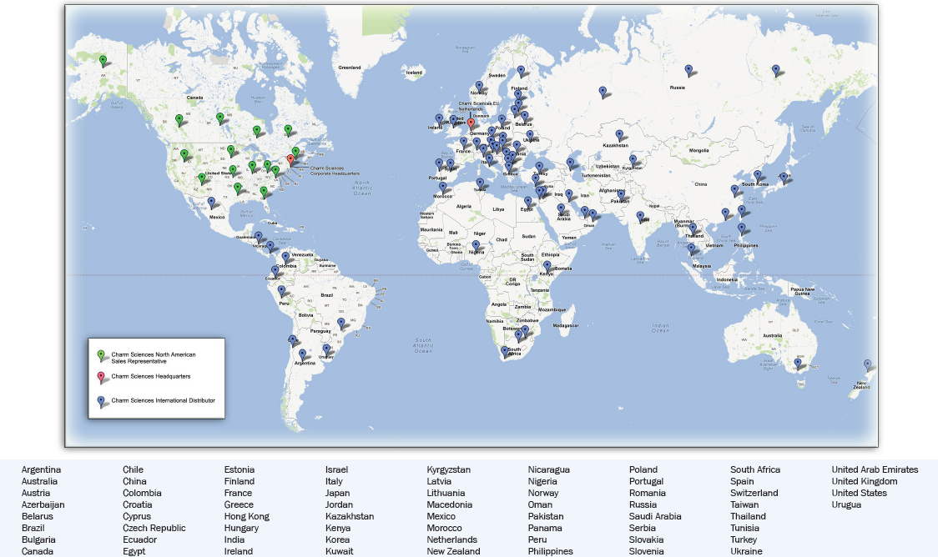
Charm Distribution in over 70 Countries

Slide 5
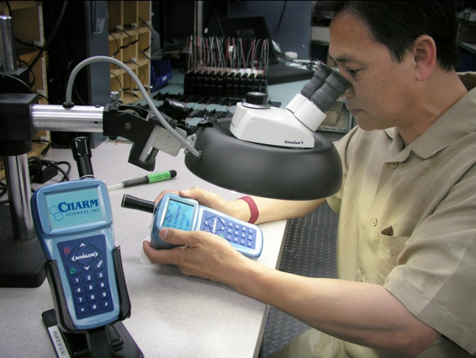
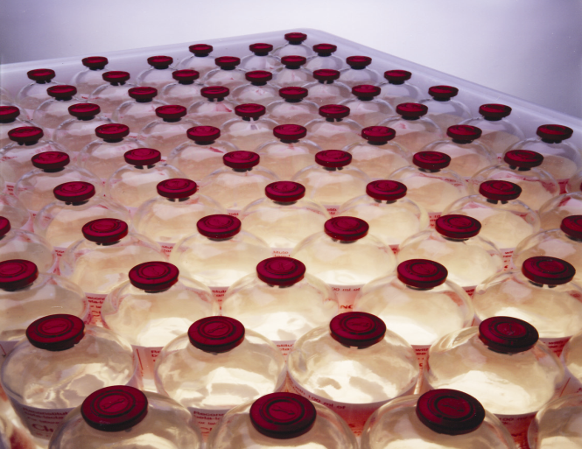



Vertically Integrated

Slide 6
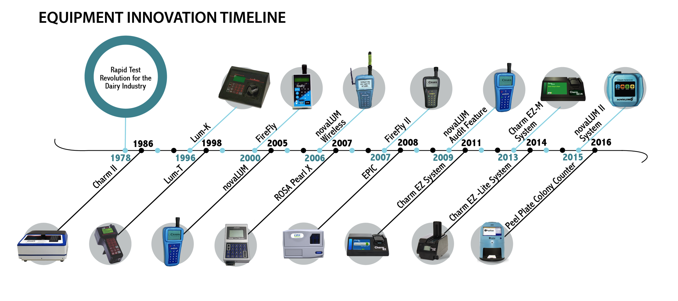
Over 40 Years of Excellence

Slide 7
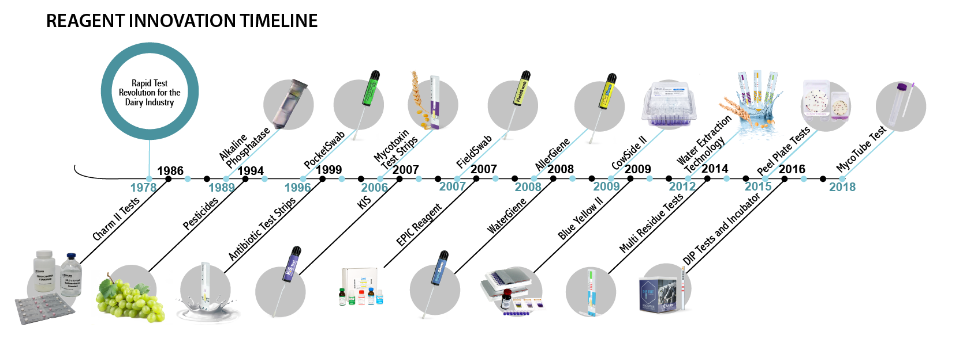
Over 40 Years of Excellence

Slide 8
Regulatory & Sampling Information

Slide 9
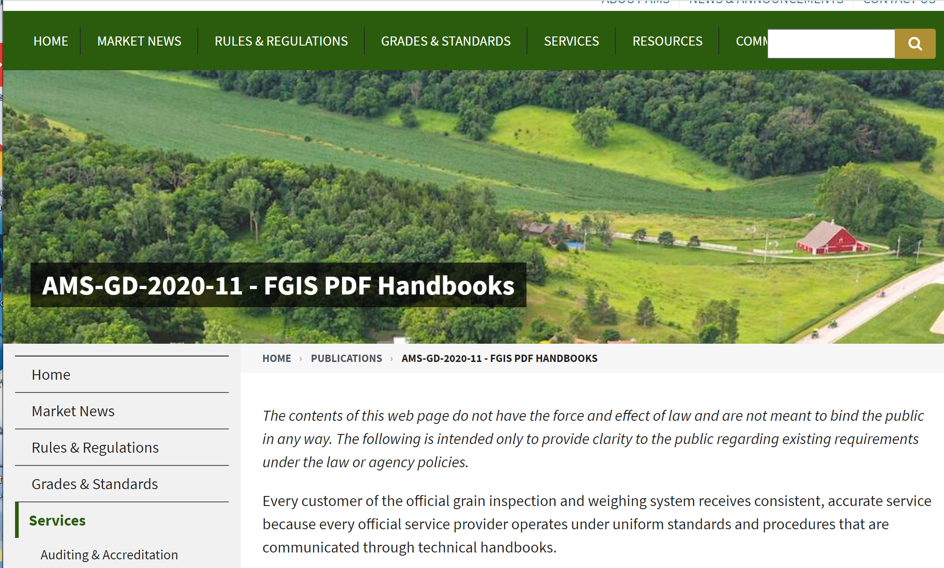
USDA - FGIS Background
Formed in 1994 (WTO)
Part of USDA Marketing and Regulatory Programs that work to promote productive and competitive global marketplace
Establishes Official standards for Grain through FGIS
Published guideline and procedural handbooks available online
2018 the Federal Grain Inspection Service separated from Packers and Stockyards Administration
https://www.ams.usda.gov/publications/content/fgis-pdf-handbooks

Slide 10
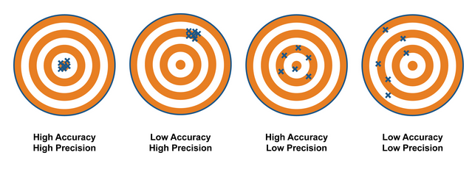
Quantitative Tests are evaluated on their
Accuracy and Precision
  Accuracy
    The mean (average) value needs to be equivalent to the true value of the sample
  Precision
    The variation between test replicates needs to be low

Slide 11

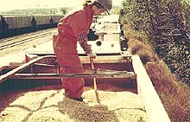
Sampling for Mycotoxin Analysis
Mycotoxins are not evenly distributed in feeds or grains
Grain from individual plants or from individual seeds/kernels from one plant, may be highly contaminated. Grain from other plants, or other seeds/kernels from those same plant may be mycotoxin-free.
The objective of sample collection is to collect a specimen from as many parts of the grain or feed pile as possible.
The size of the collected specimen depends on the size of the load or storage bin in which the grain or feed is located.
For a typical truck or wagon-load size of grain/feed, collect at least 3 lbs.
For a train-car load size of grain or feed, collect at least 10 lbs.
Sample Size | Kernels (estimate) | Variability (ppb)
10 lbs (4.5 kg) | 30,000 | 11.6-28.4
5.0 lbs (2.3 kg) | 15,000 | 8.1-31.9
2.5 lbs (1.1 kg) | 7,500 | 3.2-38.8
1.0 lbs (.45 kg) | 3,000 | 1-46.9

Slide 12
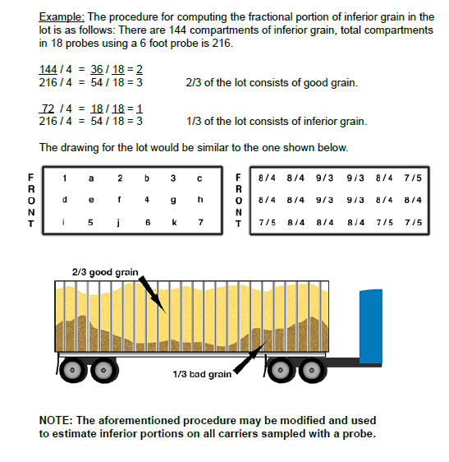
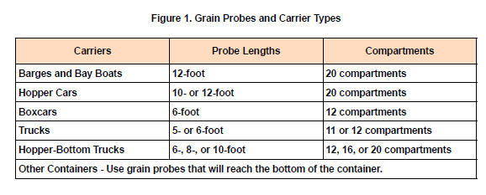
Sampling continued..
Sample Containers

Slide 13
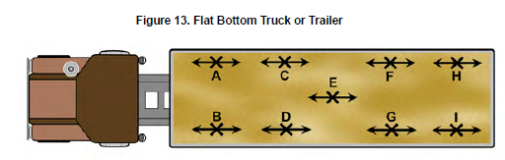
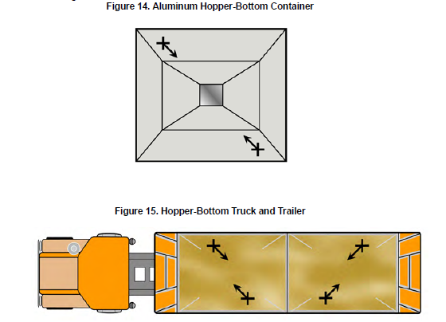
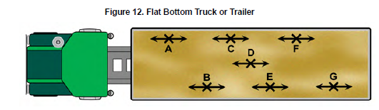
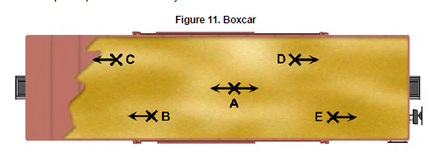
Sampling containers continued

Slide 14
Particle Size and Grinding Influence
Aflatoxin in Corn results
 | 60% 20-mesh sample |  | 99% 20-mesh sample |  | Perten ground sample
Sample # | 10 g | 50 g | 10 g | 50 g | 10 g
1 | 91 | 151 | 140 | 149 | 160
2 | 222 | 125 | 154 | 148 | 154
3 | 167 | 136 | 136 | 135 | 151
4 | 217 | 110 | 138 | 144 | 155
5 | 135 | 123 | 155 | 151 | 156
6 | 95 | 139 | 141 | 140 | 153
7 | 86 | 111 | 147 | 148 | 162
8 | 108 | 115 | 167 | 149 | 171
Average (ppb) | 140 | 126 | 147 | 145 | 158
Standard Deviation (ppb) | 56 | 15 | 11 | 5 | 7
Relative Standard Deviation | 40% | 12% | 7% | 4% | 4%

Slide 15
Time
Accuracy and Precision
Samples
Incurred samples for method validation
Ground and homogenized 50g samples
Less than 30 min
Includes sample extraction and all dilutions
Rapid test data compared to FGIS Reference Method
7 replicates per concentration tested
3 analysts
Multiple concentrations tailored to individual toxin risk
Toxins included
Aflatoxin
DON
Fumonisin
Zearalenone
Ochratoxin A
FGIS Rapid Mycotoxin Test Kit Specifications
Current FGIS Performance Verified Tests

Slide 16
Commodity Definitions - FGIS
Definitions published by FGIS in their Kit Specifications
Corn
Dent of Field Corn
Wheat
Whole Grain Wheat Flour
Malted Barley
Oats
Whole Oats with Hulls
Corn Meal
Corn Flour
Cracked Corn
Corn Grits/Polenta
Corn Screenings
Wheat Middlings
Wheat Red Dog
Wheat Flour 2nd Clear
Wheat screenings
Barley
Barley with Hulls
Hominy
Hominy grits
Rye/Rye berries
Whole grain rye flour
Rye meal
Cracked rye
Rye chops
Soybean
Whole soybeans
Full fat soy flour
Milled Rice
Brewer’s Rice
Glutinous rice

Slide 17
ROSA® Mycotoxin Tests

Slide 18

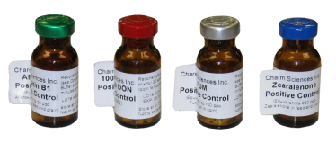
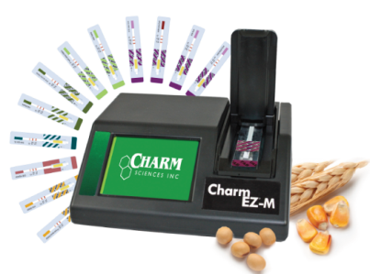
ROSA Lateral Flow Technology
Enclosed strip
  Eliminates exposure to environment.
  Prevents direct contact to employees when test is positive.
  Write-on label for Sample ID
  Store assayed strips
  Positive control supplied with kit
Controlled incubation- needed for antibody binding
  Temperature (45°C)
  Time (count down display)
Reader interpretation- Calibration curve built in the reader
  Eliminate user subjectivity
  Quantitation
  Download/print results
  Direct connect to LIMS

Slide 19


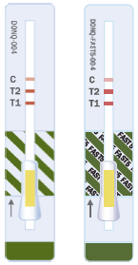
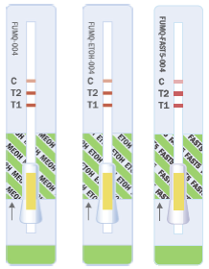
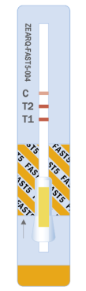


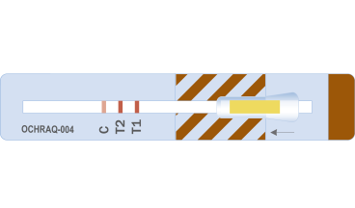
Overview of Current Charm Mycotoxin Program
Two Primary test platforms for Aflatoxin, DON, Fumonisin, Zearalenone
  WET(S) (Water Extraction Technology) utilizes extraction powder and distilled water to extract toxins in 3 - 5 minutes
  FAST(5) utilizes 70% Methanol (traditional extraction solvent) for toxin extraction in 3 - 5 minutes
For Ochratoxin and T2-HT2 70% methanol extraction in 10 minutes
Aflatoxin
DON
Fumonisin
Zearalenone
Ochratoxin
T2/HT2
3, 5, minutes
2, 5 minutes
5 minutes
5 minutes
10 minutes
10 minutes

Slide 20
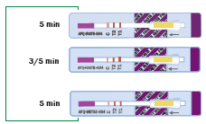
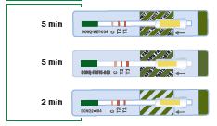




Mycotoxin Testing from A to Z
Aflatoxin
AFQ-WETS5/AFQ-WETS3
DON (Vomitoxin)
Ochratoxin
AFQ-FAST
70% Methanol and Acetonitrile methods
DONQ2
DONQ-FAST5
DONQ-WETS5
Fumonisin
FUMQ-WETS5
FUMQ-FAST5
FGIS Approved Methods
FGIS Approved Method
FGIS Approved Method
FGIS Approved Method
OCHRAQ
Includes Corn Gluten Meal
T2-HT2
Zearalenone
ZEARQ-WETS5
ZEARQ-FAST5
FGIS Approved Method
T2-HT2
FGIS Approved Method
Includes corn gluten meal

Slide 21
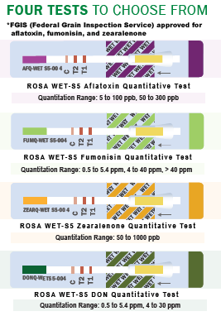

WET®-S5 Testing Options
Run 4 tests from a single sample extraction in 5 min
Extract solvents used distilled/bottled water and extraction powder
Eliminate hazardous solvents and safely analyze toxins
Dispose of negative samples in standard waste

Slide 22
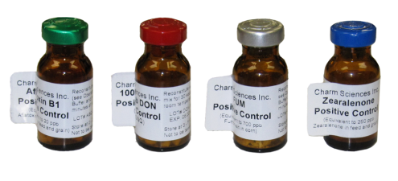
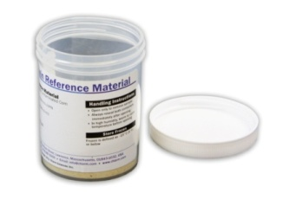
Performance Monitoring, Check Samples
Commodity Validations
Performance Monitoring
  Calibration strips provide verification of reader
  Positive and negative controls provide verification of reagent performance
Check Samples/ Reference Materials
  Provides user confidence
  Validates test procedure
  Validate new operators
Commodity Validations
  Available upon request

Slide 23
ROSA® Test Principle

Slide 24
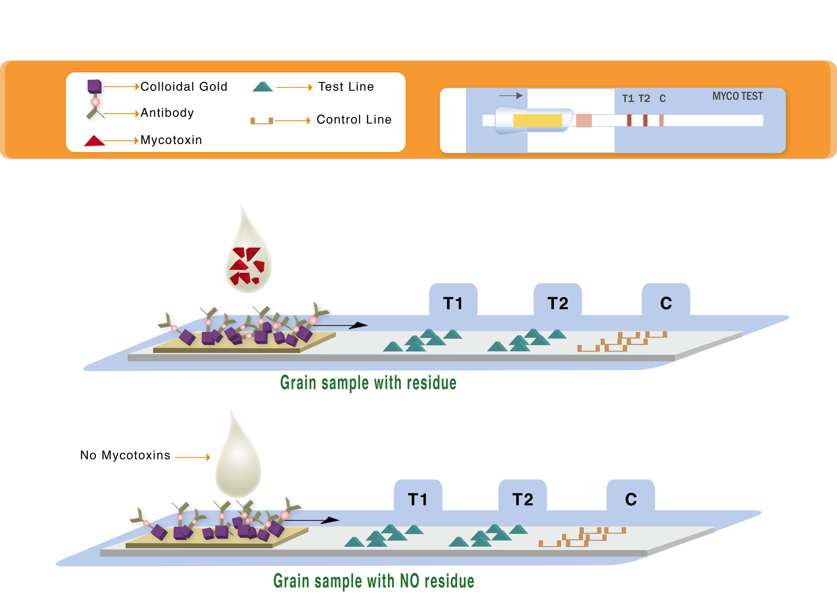
ROSA Test Principle

Slide 25
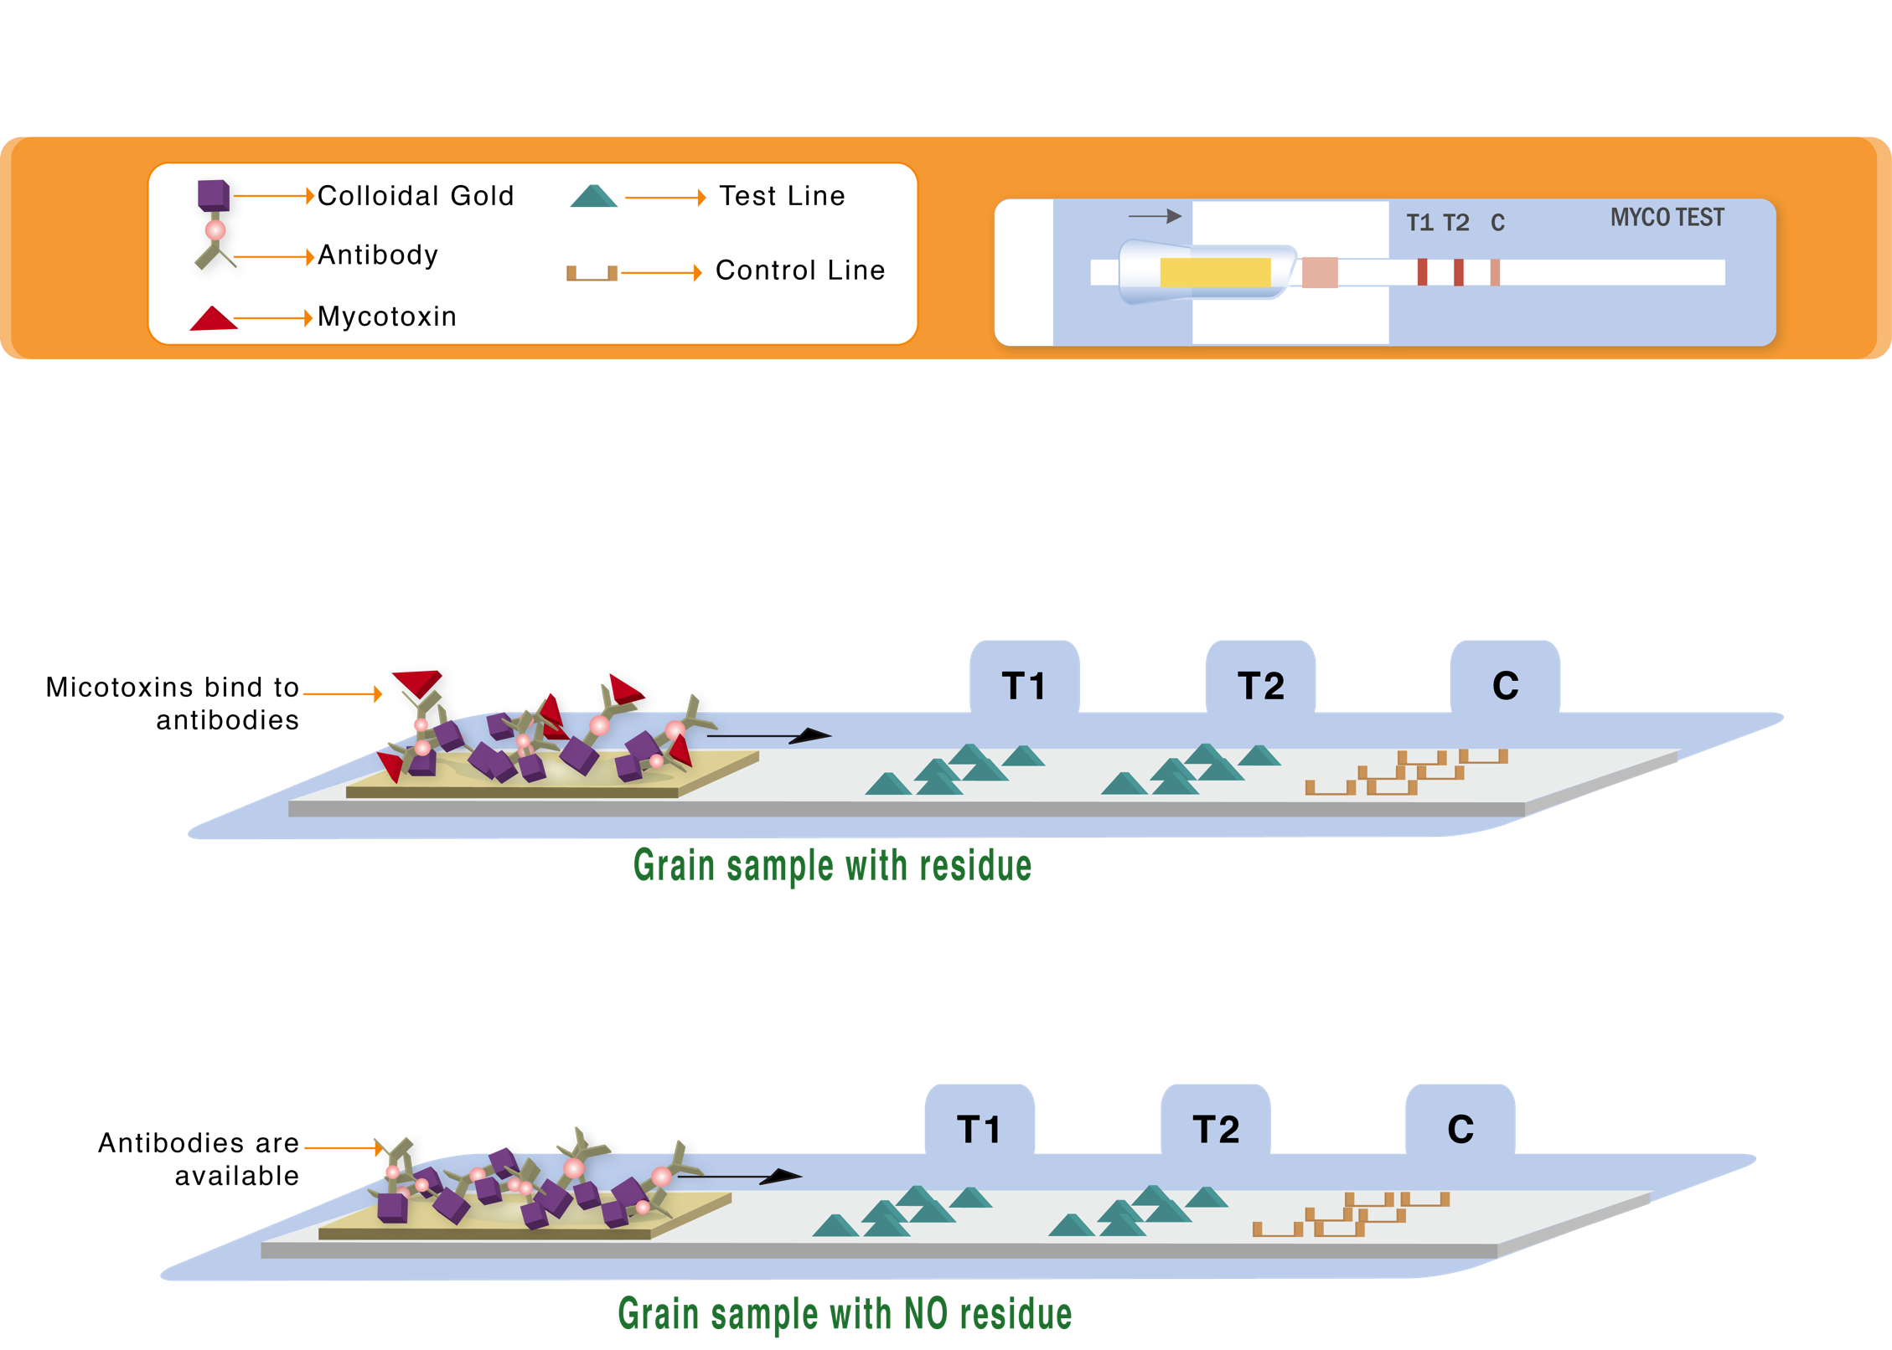
ROSA Test Principle

Slide 26
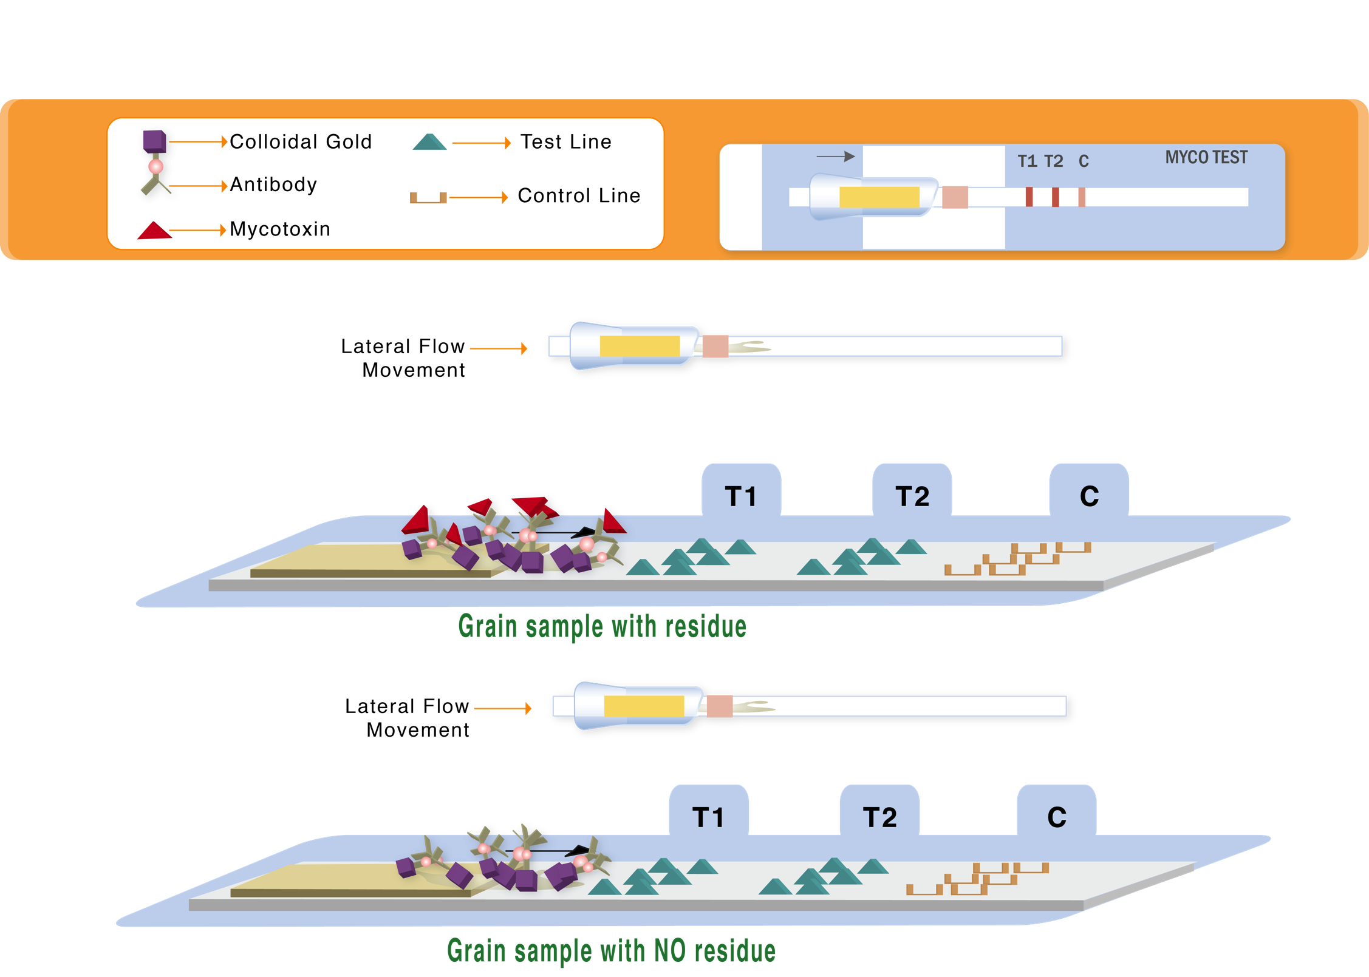
ROSA Test Principle

Slide 27
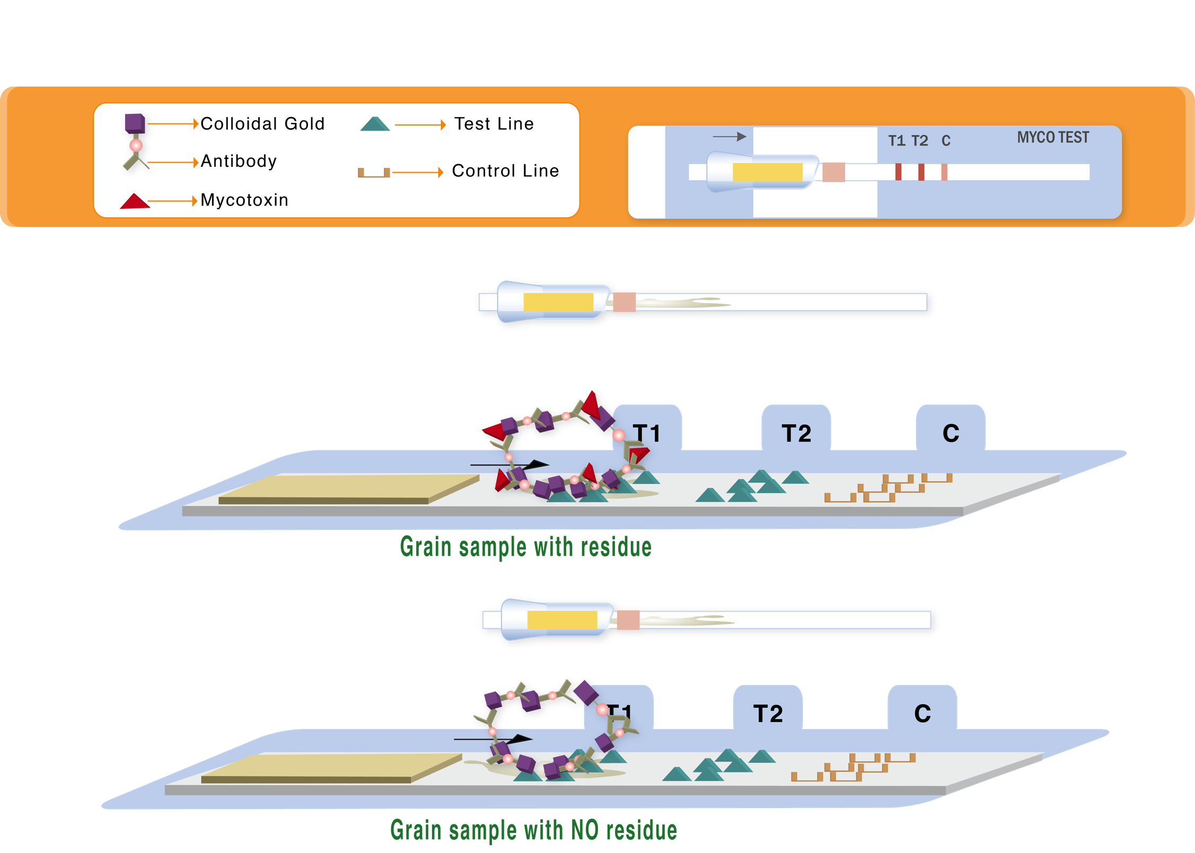
ROSA Test Principle

Slide 28
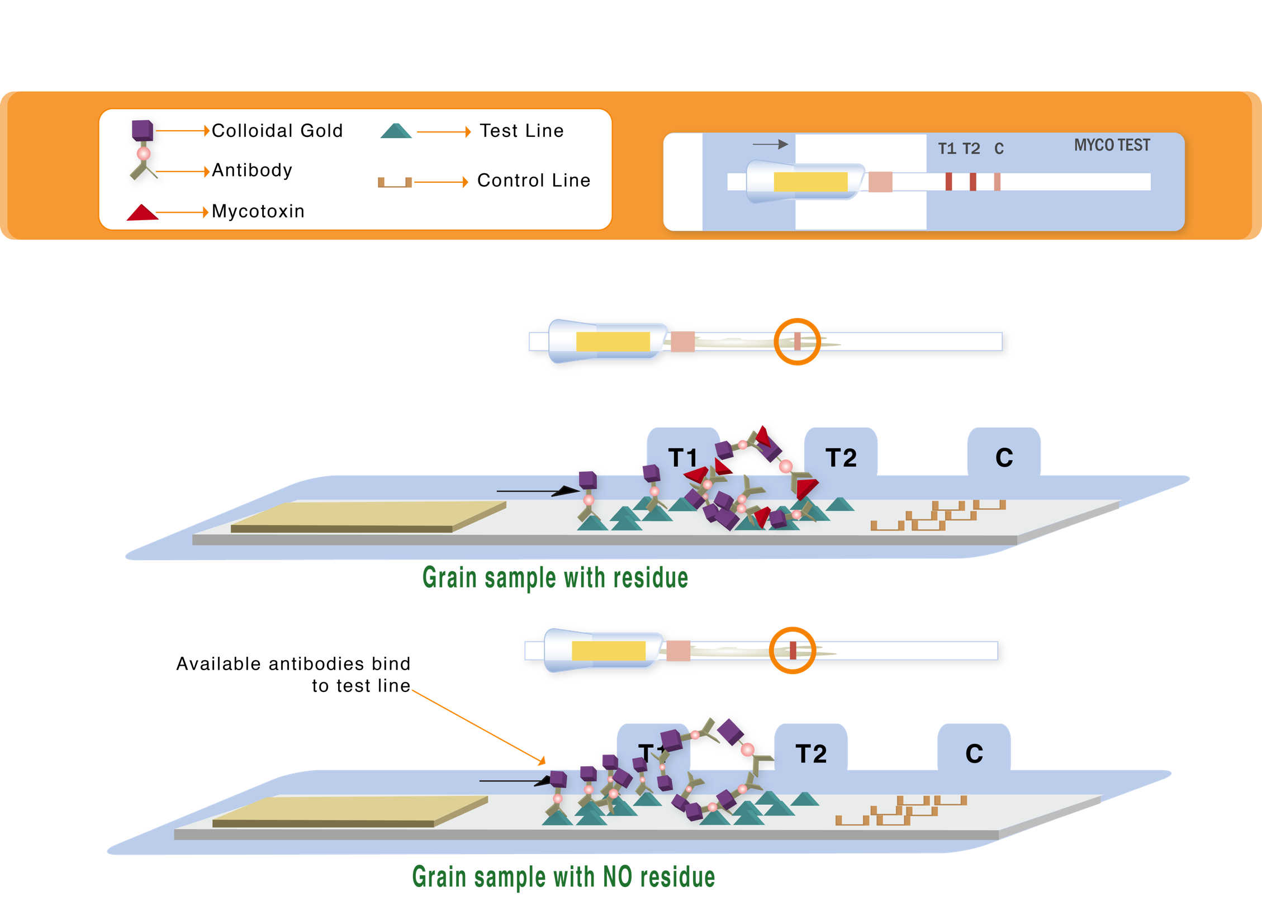
ROSA Test Principle

Slide 29
ROSA® Mycotoxin Reader Options

Slide 30
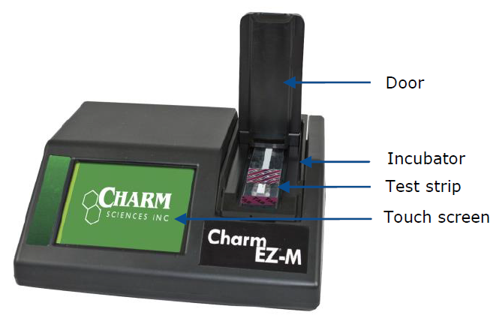
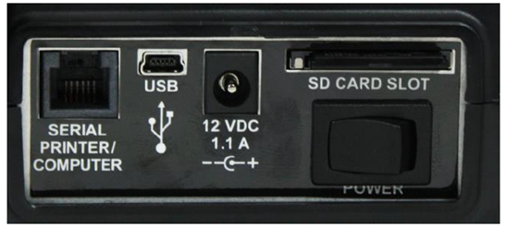
Charm EZ®-M System Overview
Allows for detection of a variety of mycotoxins across many commodities on a single platform
Compatible with all Charm ROSA Mycotoxin Lateral Flow Test strips
All results are stored on the memory of the reader and removable SD Card, and can be transferred directly to a computer.

Slide 31

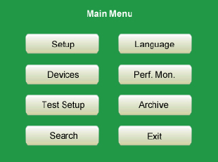
Charm EZ®-M System Start Up
Once the reader starts up, the “Insert Strip to Start” screen will appear.
  Either begin testing by inserting a Charm ROSA Mycotoxin test strip, or enter the Main Menu

Slide 32








Insert Strip to Start…
When the Charm EZ®-M is ready, the screen will read Insert Strip to Start.
Tests are recognized by the color of the end of the test strip. Each mycotoxin family has a different color

Slide 33
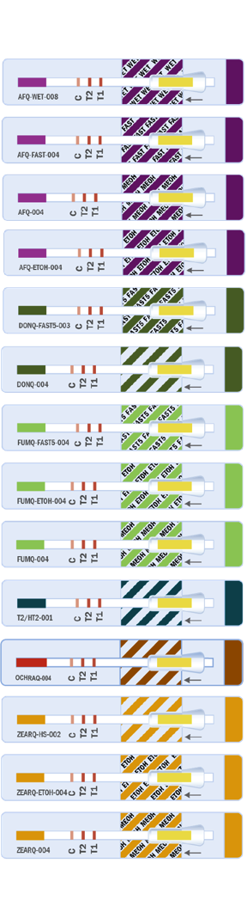

EASE OF USE REDUCES OPERATOR ERROR
Benefits
EZ-M All-In-One System recognizes Color of ROSA® Test Strip
Identifies test family automatically
Selects
  Incubation Temperature
  Incubation Time
User sets
  Commodity
  Dilution (matrices are preset)
External incubators for running multiple samples

Slide 34
REDUCES CHANCE OF OPERATOR ERROR
Benefits: Ease of Use
Built-in Diagnostics Check for operator mistakes
Data Analysis
  Results are stored on SD card for easy transfer to computer
  Ethernet connectivity available for Real Time transfer to LIMS systems
Message | Resolution
This strip is not Charm EZ-M compatible. | Remove the strip and insert the correct type.
Test has previously been run (lines detected) or reader lens is dirty. | Check the lens and run another strip.
Door was opened during assay. | Remove the used strip and discard.
Flow error detected. | Run another test and check the volume dispensed.

Slide 35
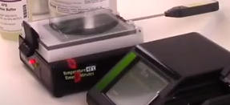
Incubator or Charm EZ®-M Temperature
Temperature of the incubator should be checked regularly.
On the Charm EZ®-M System: There is a hole directly above the Charm EZ®-M label.
On an external incubator: There is a hole underneath the hinges on the back of the incubator.
For mycotoxin testing, the temperature should read 45 ±1°C. If temperature reading is outside this range, contact Charm Sciences Support

Slide 36

Performance Monitoring
Charm Sciences suggests running calibration strips daily and controls weekly through the Perf Mon.
Performance Monitoring includes:
  Checking the temperature of the EZ®-M System or external incubator
  Running the Low and High calibration strips
  Running a Positive and Negative Control for each test that will be run that day.

Slide 37
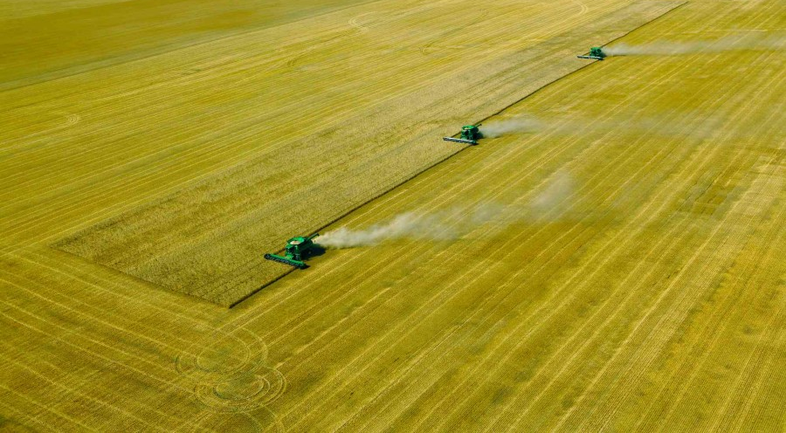
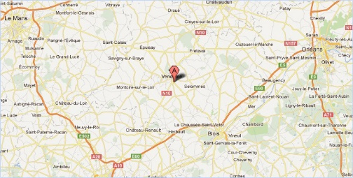
Field Testing Case Study

Slide 38
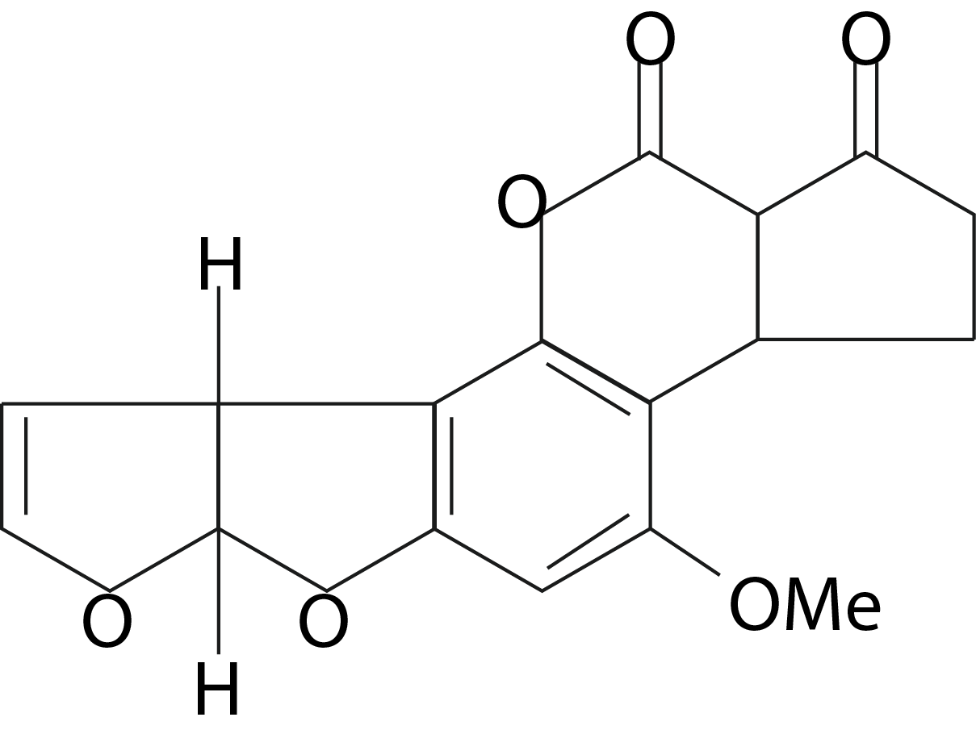
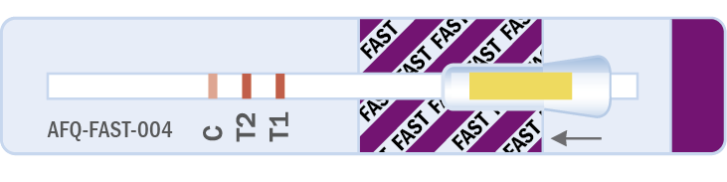
Aflatoxin

Slide 39
What is Aflatoxin?
Natural toxin, and potent carcinogen, produced by the mold Aspergillus flavis and Aspergillus parasiticus
4 Aflatoxins produced by mold growth in grains:
B1, B2, G1, G2. B1 is the predominate form (80%-95%).
Ingested Aflatoxin B1 when ingested by animals is converted to Aflatoxin M1.
This is the predominate Aflatoxin found in milk
Aflatoxins can occur pre-harvest, in the field, or post-harvest, due to delayed drying and/or improper storage at moisture levels exceeding critical levels for mold growth.

Slide 40
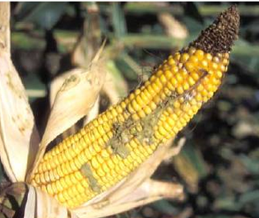
What is Aflatoxin?
Conditions that favor Aflatoxin production:
  High moisture (≥14%)
  Drought stress
  Insect damage
Aflatoxin B1 is most toxic.
  Potent liver toxin and carcinogen
  Aflatoxicosis in humans
  Group I Carcinogen
Highly regulated world wide

Slide 41
Aflatoxin Testing Options
ROSA WET®-S5 Aflatoxin Quantitative Test and ROSA WET®-S3 Aflatoxin Quantitative Test (corn only)
FGIS Accuracy Requirements
FGIS Approved Commodities
Utilizes distilled water and WETS extraction powder
Single sample extractions allow multiple WET®-S5 toxin tests to be performed
AFQ-WET®-S5 is 5 min incubation for all, including corn
AFQ-WET®-S3 is 3 min and approved for corn only
Total Aflatoxin Concentration (ppb) | Acceptable Range | Maximum RSD
5.0 | 2.5 – 7.5 | 25%
10 | 5.6 – 14.4 | 22%
20 | 12 - 28 | 20%
100 | 86 - 132 | 16%
300 | 200 – 400 | 16%
ROSA FAST Aflatoxin Quantitative Test
FGIS Approved Test Kit
Utilizes 70% Methanol
Charm approved commodities
5 min incubation time, 3 min for corn

Slide 42
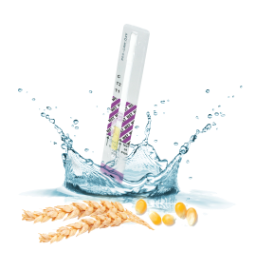
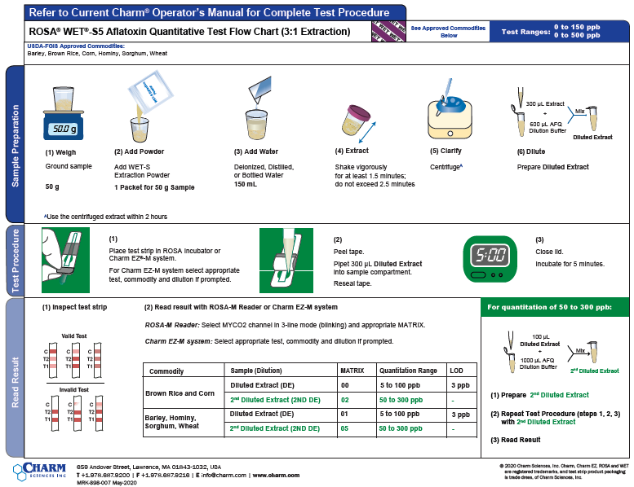
ROSA WET®-S5 Aflatoxin Quantitative Test
1 Extraction Packet with distilled water
FGIS Approved Commodities
3:1 Extraction Ratio
Barley
Brown Rice
Corn
Hominy
Sorghum
Wheat
Awarded 5-year USDA FGIS contract for AFQ-WET®-S5 test to monitor US Grain and Feed for Aflatoxin

Slide 43
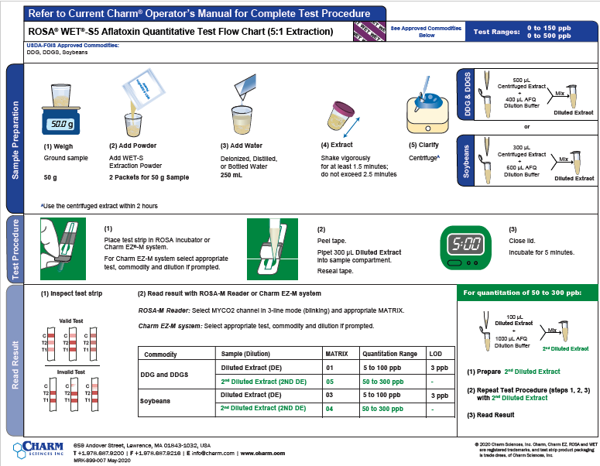
ROSA WET®-S5 Aflatoxin Quantitative Test
2 Extraction Packets with distilled water
FGIS Approved Commodities
5:1 Extraction Ratio
DDG
DDGS
Soybean
Awarded 5-year USDA FGIS contract for AFQ-WET®-S5 test to monitor US Grain and Feed for Aflatoxin

Slide 44
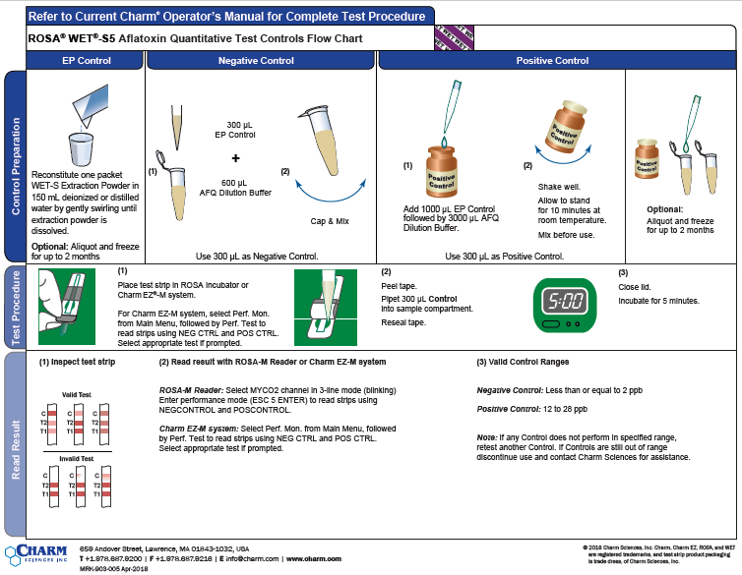
ROSA WET®-S5 Aflatoxin Quantitative Test
Negative and Positive Controls

Slide 45
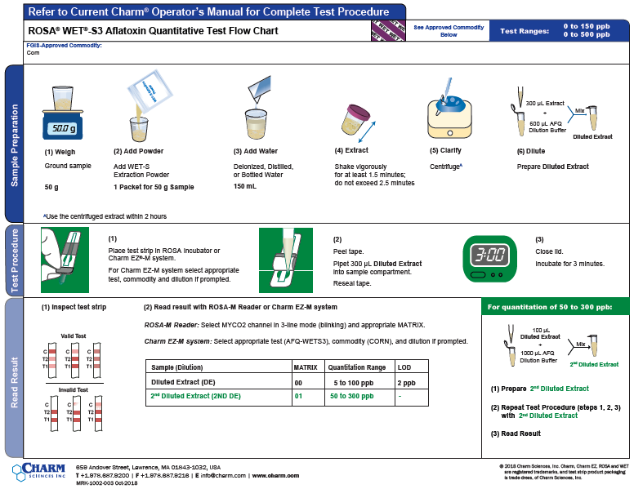
ROSA WET®-S3 Aflatoxin Quantitative Test
Corn Only
FGIS Approved Commodities
3:1 Extraction Ratio
Corn

Slide 46
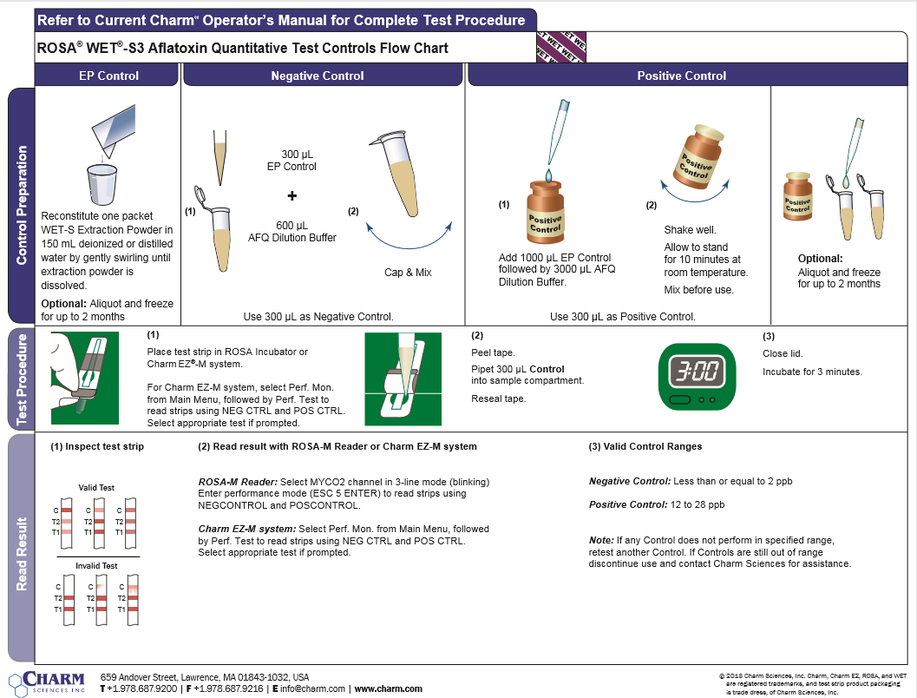
ROSA WET®-S3 Aflatoxin Quantitative Test
Negative and Positive Controls

Slide 47
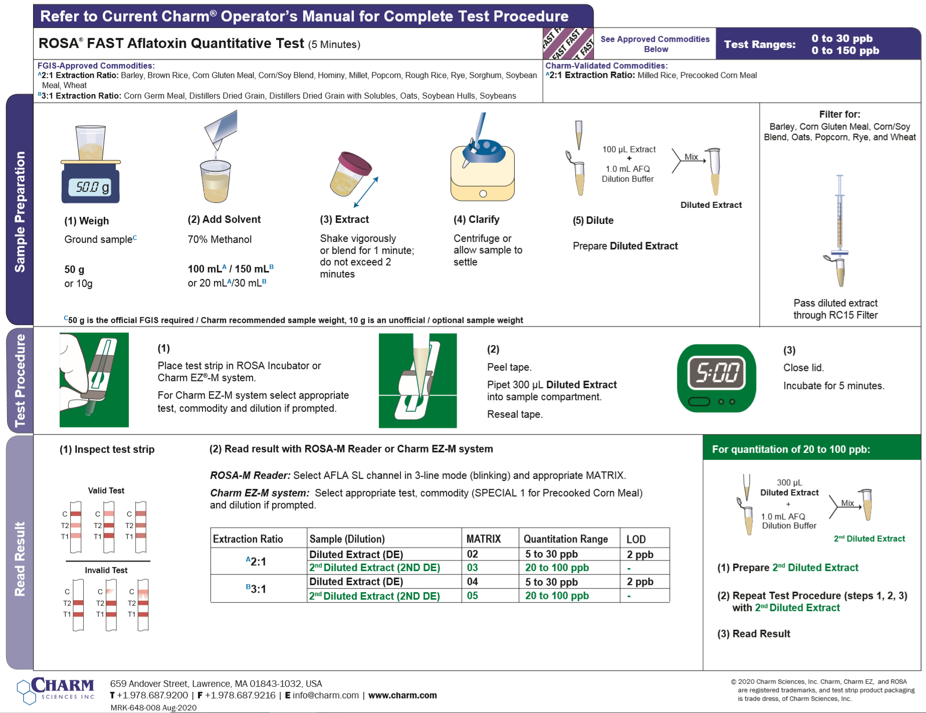
ROSA FAST Aflatoxin Quantitative Test
FGIS Approved Commodities
2:1 and 3:1 Extraction Ratio Flow Chart
2:1 Extraction Ratio
Barley
Brown Rice
Corn Gluten Meal
Corn*
Corn/Soy Blend
Hominy
Millet
Popcorn
Rough Rice
Rye
Sorghum
Soybean Meal
3:1 Extraction Ratio
Corn Germ Meal
DDG
DDGS
Oats
Soybean Hulls
Charm Approved Commodity
Milled Rice
Corn bran
*3 min incubation
Awarded USDA FGIS contract for AFQ-FAST test to monitor US Grain and Feed for Aflatoxin

Slide 48
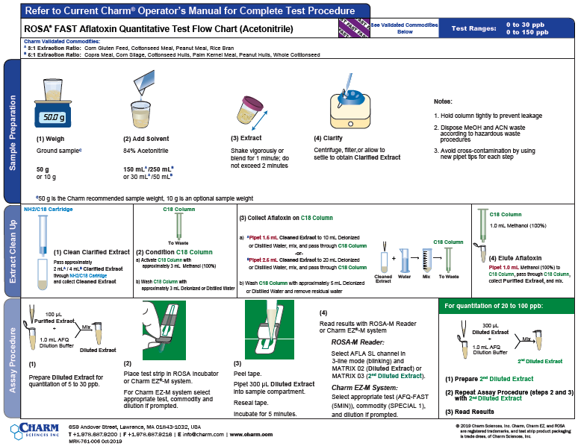
ROSA FAST Aflatoxin Quantitative Test
Acetonitrile Extraction Flow Chart
Charm Approved Commodities
3:1 Extraction Ratio
Corn Gluten Feed
Cottonseed Meal
Peanut Meal
Rice Bran
5:1 Extraction Ratio
Copra Meal
Corn Silage
Cottonseed Hulls
Palm Kernel Meals
Peanut Hulls
Whole Cottonseed

Slide 49
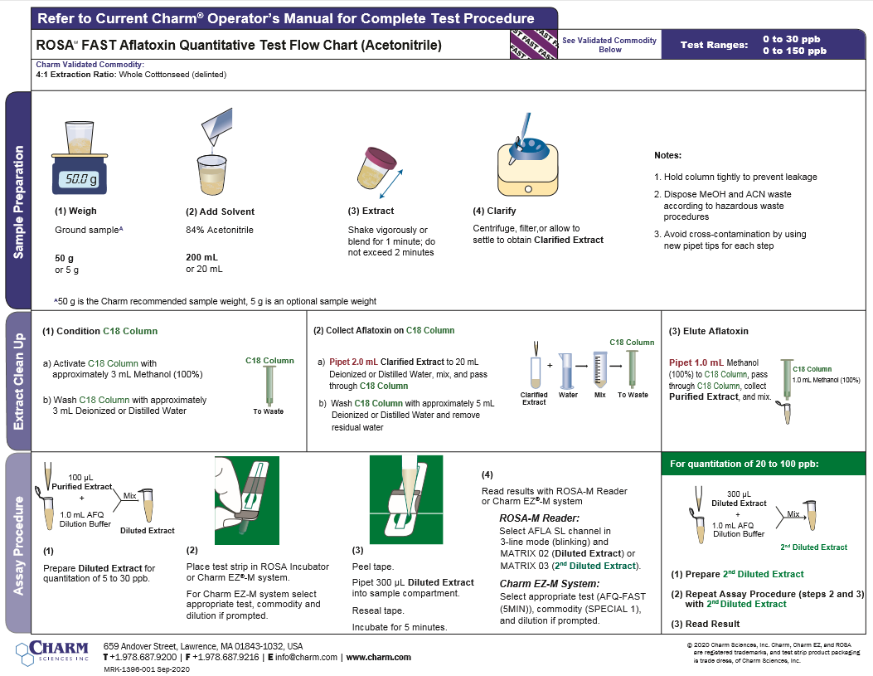
ROSA FAST Aflatoxin Quantitative Test
Whole Cottonseed (delinted) Flow Chart

Slide 50

ROSA FAST Aflatoxin Quantitative Test
Negative and Positive Controls

Slide 51

Vomitoxin (DON)

Slide 52
Deoxynivalenol (DON)….Vomitoxin
Mycotoxin produced by fungi of the Fusarium genus (e.g., F. graminearium)
Found in wheat, corn, barley, sorghum, oats & rye – pre and post harvest
Found in processed grains: malt beer and bread
Fusarium species need 17-19% moisture content for growth
DON is the most prevalent mycotoxin in European crops
DON has a great stability during storage/milling and does not degrade at high temperatures
Other toxins produced by Fusarium species: Fumonisin, Zearalenone and T2HT2

Slide 53
Why Test for DON
Malters test Barley for DON – “gushing” in packaged beer
http://www.brewingtechniques.com/bmg/gudmestad.html
Millers test flour for DON
DON has a potent immunosuppressive activity
Causes feed refusal in swine and weight loss from inflated serotonin levels and inhibited protein systhesis
At high doses it can induce vomiting

Slide 54
DON (Vomitoxin) Testing Options
ROSA DONQ2 Quantitative Test
FGIS Approved Commodities
Utilizes distilled water
2 min incubation
Total DON* Concentration (ppm) +/- 15% | Acceptable Range | Maximum RSD
0.50 | 0.300 – 0.700 | 20%
1.0 | 0.68 – 1.3 | 16%
2.0 | 1.5 – 2.5 | 12%
5.0 | 4.0 – 6.0 | 10%
30 | 24 - 36 | 10%
ROSA FAST5 DON Quantitative Test
Charm Approved Commodities
Utilizes distilled water
5 min incubation
ROSA WET®-S5 DON Quantitative Test
Charm Approved Commodities
Utilizes distilled water and WETS extraction powder
Single sample extractions allow multiple WET®-S5 toxin tests to be performed
5 min incubation

Slide 55

ROSA DONQ2 Quantitative Test
FGIS Approved
5:1 Extraction Ratio in Distilled Water
  Buckwheat
  Barley
  Brown rice
  Corn
  Corn Bran
  Corn Germ Meal
  Corn Gluten Feed
  Corn Gluten Meal
  DDGS
  Hominy
  Malted Barley
  Milled Rice
  Oats
  Rice Bran
  Rough Rice
  Rye
  Sorghum
  Soybean Meal
  Triticale
  Wheat
  Wheat Bran
Charm Approved
Palm Kernel Meal
Pearled Barley
Rapeseed Meal
Awarded 5-year USDA FGIS contract for DONQ2 test to monitor US Grain and Feed for Deoxynivalenol

Slide 56

ROSA DONQ2 Quantitative Test
Negative and Positive Control

Slide 57

ROSA FAST5 DON Quantitative Test
Charm Approved
5:1 Extraction Ratio in Distilled Water
  Barley
  Brewer’s Rice
  Buckwheat
  Corn
  Corn Bran
  Corn Germ Meal
  Corn Gluten Feed
  DDGS
  Hominy
  Malted Barley
  Milled Rice
  Oats
  Palm Kernel Meal
  Rapeseed Meal
  Rice Bran
  Rough Rice
  Rye
  Sorghum
  Soybean Meal
  Triticale
  Wheat
  Wheat Bran
  Wheat Flour
  Wheat Midds
  Wheat Red Dog
  Wheat Screenings

Slide 58

ROSA FAST5 DON Quantitative Test
Negative and Positive Control

Slide 59

ROSA WET®-S5 DON Quantitative Test
Charm Approved
  1 extraction packets and 150mL :
  Corn
  Wheat
  2 extraction packets and 250 mL
  Barley

Slide 60

ROSA WET®-S5 DON Quantitative Test
Negative and Positive Control

Slide 61


Fumonisin

Slide 62
Background to Fumonisin
Fumonisins are produced by fungi in the genus Fusarium e.g., F. verticillioides and F. proliferatum
Fumonisins have been implicated as a possible cause of human esophageal cancer, equine leukoencephalomalacia, a serious disease in horses, and Pulmonary edema in swine.
Kernels that are infected with Fusarium verticillioides are more brittle than healthy kernels. As a result, these infected kernels break during harvest and drying, and end up in the screenings. For this reason horses and swine should not be fed corn screenings.
Hepatoxic in rabbits, pigs, sheep, rat, and mice

Slide 63
Fumonisin Testing Options
FGIS Accuracy Requirements
ROSA WET®-S5 Fumonisin Quantitative Test
FGIS Approved Test kit
Utilizes distilled water and WET®-S5 extraction powder
5 min incubation time
Total Fumonisin Concentration (ppm) | Acceptable Range | Maximum RSD
0.500 | 0.32 – 0.68 | 20%
2.00 | 1.4 – 2.6 | 16%
5.00 | 3.7 – 6.3 | 12%
30.00 | 22 – 38 | 10%
ROSA FAST5 Fumonisin Quantitative Test
Utilizes 70% Methanol
Charm approved commodities
5 min incubation time

Slide 64

ROSA WET®-S5 Fumonisin Quantitative Test
1 Extraction Packet with Distilled Water
FGIS Approved Commodities
  3:1 Extraction Ratio
  Corn
  Oats
  Popcorn
  Sorghum
  Wheat
  Charm Approved Commodities
  Millet
  Rough Rice

Slide 65

ROSA WET®-S5 Fumonisin Quantitative Test
2 Extraction Packet with Distilled Water
FGIS Approved Commodities
5:1 Extraction Ratio
Corn Germ Meal
DDGS
Charm Approved Commodities
Barley
Corn Gluten Feed

Slide 66

ROSA WET®-S5 Fumonisin Quantitative Test
Negative and Positive Controls

Slide 67

ROSA FAST5 Fumonisin Quantitative Test
Charm Approved Commodities
  2:1 Extraction Ratio
  Barley
  Corn
  Corn Gluten Meal
  Flaking Corn Grits
  Millet
  Oat Groats
  Rough Rice
  Sorghum
  Wheat
  3:1 Extraction Ratio
  DDGS
  Corn Germ Meal

Slide 68

ROSA FAST5 Fumonisin Quantitative Test
Negative and Positive Controls

Slide 69

Ochratoxin

Slide 70
Background to Ochratoxin
It is produced by species of Aspergillus, such as A. ochraceus, in tropical regions and by Penicillium verrucosum in cooler climates
Porcine most sensitive animal
Nephropathy
Kidney

Slide 71
ROSA®® Ochratoxin Quantitative Test
FGIS Testing Specifications
ROSA Ochratoxin Quantitative Test for Feed and Grain
Total Ochratoxin Concentration (ppb) | Acceptable Range | Maximum RSD
5 | 3 - 7 | 20%
20 | 12 - 28 | 20%
100 | 60 - 140 | 20%
FGIS Approved test
Utilizes 70% Methanol
10 minute incubation
*FGIS doesn’t certify testing concentrations > 100 ppb

Slide 72

ROSA Ochratoxin Quantitative Test for Feed and Grain
2:1 Extraction Procedural Flow Chart
Approved Commodities
  FGIS Approved Extraction Ratio
  Barley
  Buckwheat
  Corn
  Corn Gluten Meal
  Malted Barley
  Oat Groats
  Rye
  Sorghum
  Soybean Meal
  Soybeans
  Wheat
Charm approved
  Ginger root
  Rice
  Beet pulp
  Brown Rice
  Brewer’s Rice

Slide 73

ROSA Ochratoxin Quantitative Test for Feed and Grain
Negative and Positive Controls

Slide 74

T2-HT2

Slide 75
T2-HT2 - Trichothecenes include Fusarmium
T2 and HT2 are produced by Fusarium species when grown under moist conditions
T2 is the toxin and HT2 is the primary metabolite
Cross Reactivity: T-2 Toxin (100%) and HT-2 Toxin (100%)
Porcine most sensitive
Immune System Depression
Induces red and white blood cell toxicity
T2 and metabolites inhibit protein, RNA, and DNA synthesis
Validated for multiple commodities including barley, corn, oats, and wheat

Slide 76
T2/HT2 Testing Options
Currently, there is no regulation of T2/HT2 in the USA. The list of commodities below are based on Charm in-house validation
Barley
Corn
Corn Gluten Meal
Oats
Sorghum
Soybean Meal
Wheat
Wheat Flour
Commodity | Conc (ppb) | Average ± SD (ppb)
Barley | ND 50 200 | 1 51 ± 7.5 221 ± 14.3
Oats | ND 50 200 | 2 53 ± 11.1 209 ± 20.3
Wheat | ND 50 200 | 1 45 ± 6.8 194 ± 42
Methanol Solvent
10-minute incubation

Slide 77

ROSA T2/HT2 Quantitative Test
Procedure for all commodities

Slide 78

ROSA T2/HT2 Quantitative Test
Negative and Positive Controls

Slide 79

Zearalenone

Slide 80
Background to Zearalenone
Mycotoxin produced by fungi of the Fusarium genus
Estrogenic toxin – swine and poultry susceptible
DON and Zearalenone often occur together
In stored grain, Zearalenone production is favored by grain moisture in excess of 20.5% and 70-85 F temperatures

Slide 81
ROSA® Zearalenone Testing Options
ROSA WET®-S5 Zearalenone Quantitative Test
FGIS Approved Commodities
Utilizes distilled water and WETS extraction powder
Single sample extractions allow multiple WET®-S5 toxin tests to be performed
5 min incubation
Total Zearalenone Concentration (ppm) | Acceptable Range | Maximum RSD
100 | 50 - 150 | 25%
250 | 150 - 350 | 20%
1000 | 600 - 1400 | 20%
ROSA FAST5 Zearalenone Quantitative Test
Charm Approved Commodities
Utilizes 70% methanol
5 min incubation

Slide 82

ROSA WET®-S5 Zearalenone Quantitative Test
1 Extraction Packet in Distilled Water
FGIS Approved
  Corn
  Sorghum
  Wheat

Slide 83

ROSA WET®-S5 Zearalenone Quantitative Test
2 Extraction Packet in Distilled Water
FGIS Approved
  DDGS

Slide 84

ROSA WET®-S5 Zearalenone Quantitative Test
Negative and Positive Controls

Slide 85

ROSA FAST5 Zearalenone Quantitative Test
3:1 Commodities Flow Chart
Charm Approved
  Barley
  Brewer’s Rice
  Corn
  DDGS
  Flaking Corn Grits
  Milled Rice
  Oats
  Rice
  Rough Rice
  Rye
  Sorgum
  Soybean Meal
  Wheat
  Wheat Bran
  Wheat Flour

Slide 86

ROSA FAST5 Zearalenone Quantitative Test
Corn Gluten Meal
Charm Approved
  Corn Gluten Meal

Slide 87

ROSA FAST5 Zearalenone Quantitative Test
Negative and Positive Controls

Slide 88
Supplemental Analysis Flow Charts
Quantitating toxins are a higher concentration

Slide 89

ROSA WET®-S5 Fumonisin Quantitative Test – high ppm

Slide 90

ROSA FAST5 DON Quantitative Test – HIGH PPM

Slide 91
Thank You!

