Slide 1
Charm® Mycotoxin Competitors

Slide 2
Competitors – Who are they?

Slide 3
Mycotoxin Competitors - links

Slide 4
ELISA vs Lateral Flow

Slide 5
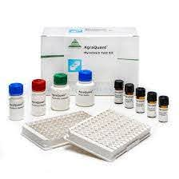
ELISA – instructional video

Slide 6
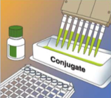
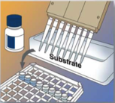
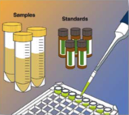
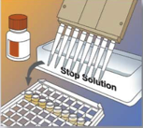
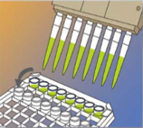
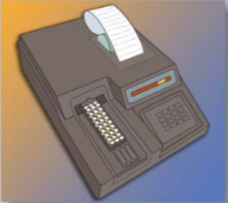
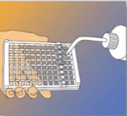
A Typical ELISA Procedure (Enzyme-Linked ImmunoSorbent Assay)
Step 1:
Conjugate is added to dilution well
Step 5:
Substrate is added to each well, and incubate.
Step 2:
Standards/samples are added to conjugate in individual well
Step 6:
Stop-solution is added to stop the reaction
Step 3:
Mixture is transferred to Antibody-coated well, and incubate
Results are read using a spectro-photometer/ELISA reader at the appropriate wavelength
Step 4:
Washing step follows to remove all un-bound conjugate
Note: Several steps required after sample preparation and pipetting technique is crucial

Slide 7
Comparison of ROSA Strip and ELISA
CRITERIA | LATERAL FLOW | ELISA
1. Technicality | Simple, easy to use, minimal training required. | Pipetting technique is crucial; requires practice
2. Turn-around time | Fast around 2 – 10 minutes; depending on test | Around 10 – 30 minutes; depending on test
3. Number of Steps | 1-step post sample preparation | 5 – 7 steps post sample preparation
4. Accuracy | Comparable to HPLC for validated commodities | Comparable to HPLC for validated commodities (refer to suppliers)
5. On-site testing | Possible | Not suitable

Slide 8
Comparison of ROSA Strip and ELISA (cont’d)
CRITERIA | LATERAL FLOW | ELISA
Environmental Condition | Not affected by ambience temperature | Required to be run at 22-25 ^{O}C.
7. Cost per Test | Independent of the number of test/run | High cost for single sample run. Cost efficient only when batching
8. Extraction Solution | Versatile – ethanol, methanol or water extraction possible for some toxins. | Only methanol extraction (except DON with water).
9. Quantitation | EZ-M reader | Spectrophotometer (with 450/650nm filter)
10. Approval | Most tests approved by USDA-GIPSA | Depends on ELISA kit manufacturers

Slide 9
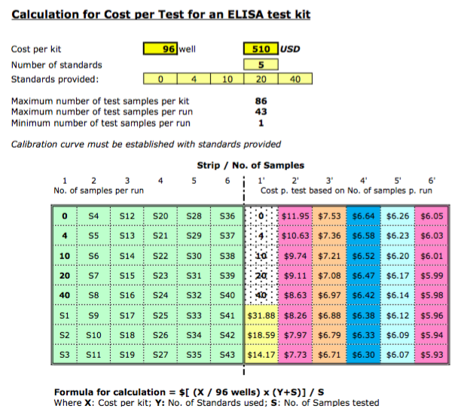

Slide 10
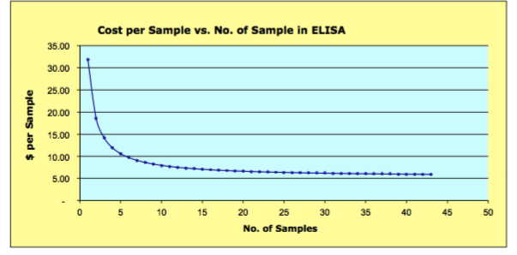
Cost per Test for ELISA

Slide 11
ELISA – Differences
With ELISA – cost per test is extremely variable depending on how many samples you run at a time because each batch requires 3-5 standards be run. If facilities are waiting for a large batch of samples to keep their cost low, then trucks are waiting.
With Charm – the cost per test is the same regardless if you run 1 test or batch tests which means you can keep your truck lines moving.
With ELISA –one toxin is run at a time.
With Charm – multiple toxins can be run on the same sample at the same time and read immediately in the reader without making any changes to the reader.
Test time is much faster with Charm than ELISA and the number of steps involved in testing is significantly less.

Slide 12
Time
Accuracy and Precision
Samples
Incurred samples for method validation
Ground and homogenized 50g samples
Less than 30 min
Includes sample extraction and all dilutions
Rapid test data compared to FGIS Reference Method
7 replicates per concentration tested
3 analysts
Multiple concentrations tailored to individual toxin risk
Toxins included
Aflatoxin
DON
Fumonisin
Zearalenone
Ochratoxin A
FGIS Rapid Mycotoxin Test Kit Specifications
Current FGIS Performance Verified Tests

Slide 13
Thank You!

